Slide 1
SOLAR TRACKER
PRESENTED By :
AKASH.A(22AI001)
SANTHOSH RAJ.P(22AI047)
SHARATH.R(22AI049)
Guided By :
Dr.K.Lalitha
TEAM NO: 1
22AIC14 & INTERNET OF THINGS AND ITS APPLICATIONS

Slide 2
Abstract:
The "Solar Tracker with Movable Wheels" project aims to enhance solar panel efficiency by incorporating dual-axis tracking with mobility.
The solar tracker follows the sun’s movement to optimize energy capture, while the wheels allow the system to be repositioned for better sunlight exposure throughout the day.
This design offers greater flexibility and adaptability, especially in changing environments, making it more efficient compared to stationary systems.

Slide 3
Objectives:
The primary objective of this project is to design and implement a solar tracker that can autonomously follow the sun while being able to move its entire structure using wheels.
This allows for optimal sunlight capture regardless of location.
The project also aims to improve energy generation efficiency and demonstrate the practicality of combining solar tracking with mobility in dynamic environments.

Slide 4
Components:
Arduino Uno: Acts as the brain of the system, controlling the servos and reading data from the sensors (LDR).
Servo Motor: Used for the dual-axis solar tracking to rotate the panel toward the sun.
Power Supply for Arduino: Provides the necessary voltage to power the Arduino and connected components.
LDR (Light Dependent Resistor): Senses the intensity of sunlight and helps adjust the solar panel's direction.
Connecting Wires: For linking the components together.
Small Solar Panel: The prototype panel, which will be adjusted to track the sun’s position.
1k Resistor: Likely used with the LDR for signal stabilization in the sensor circuit.

Slide 5
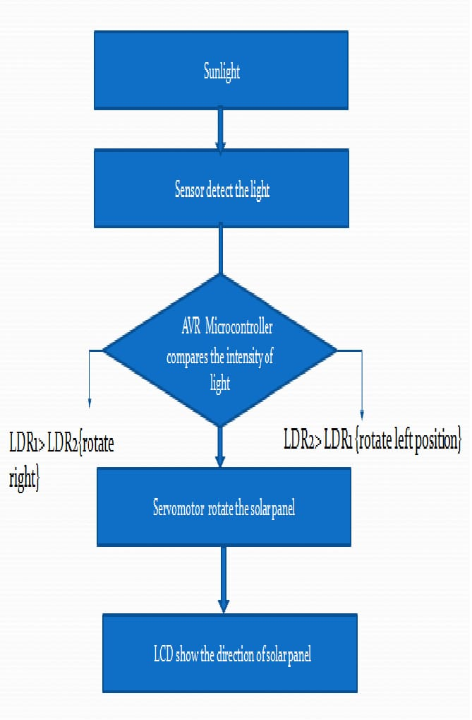
Flow Diagram:

Slide 6
Implementation:
The implementation of the project involves both hardware assembly and software programming.
The hardware includes installing motors, sensors, and wheels the solar tracker frame, with all components connected to the microcontroller.
The software is responsible for interpreting sensor data to control the motors and wheels, ensuring real-time solar tracking and mobility.
Testing and debugging were conducted to ensure smooth functionality and system optimization.

Slide 7
Thank You

